Slide 1
Project 1
Weather App

Slide 2
Question Set
Objective: In this project, you will create a web-based weather application that allows users to
enter a location and retrieve the current weather conditions for that location. The app should
display details such as temperature, weather description, and an icon representing the current
weather.

Slide 3
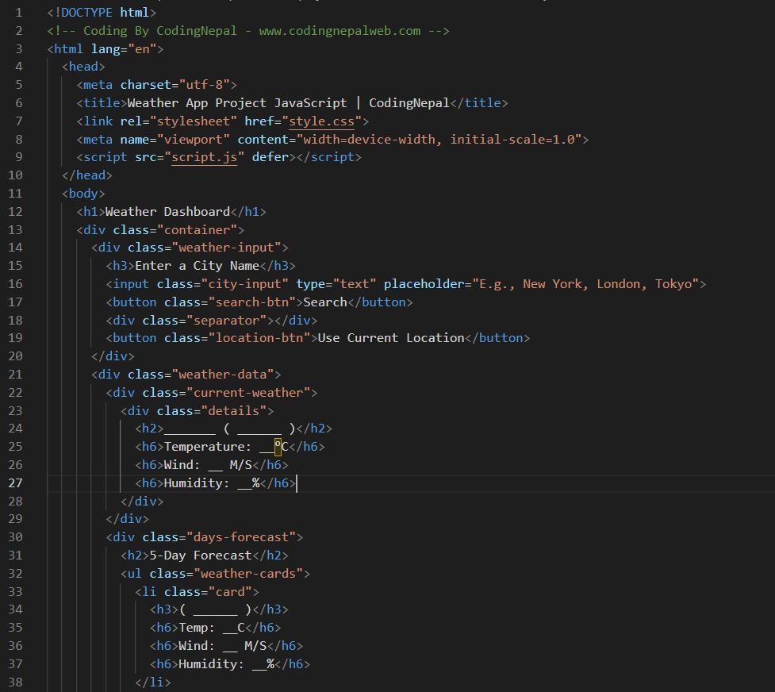
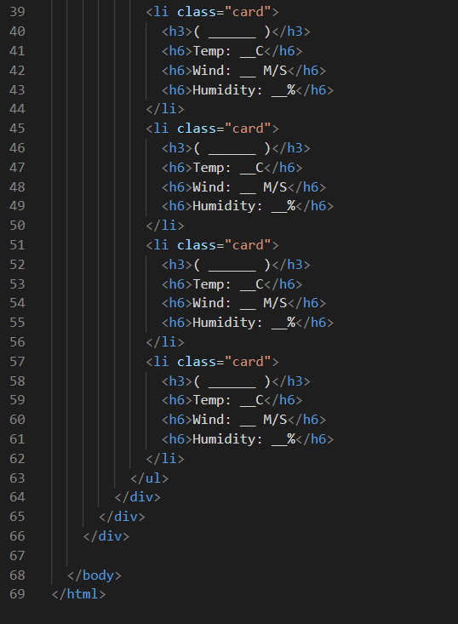
HTML Code

Slide 4
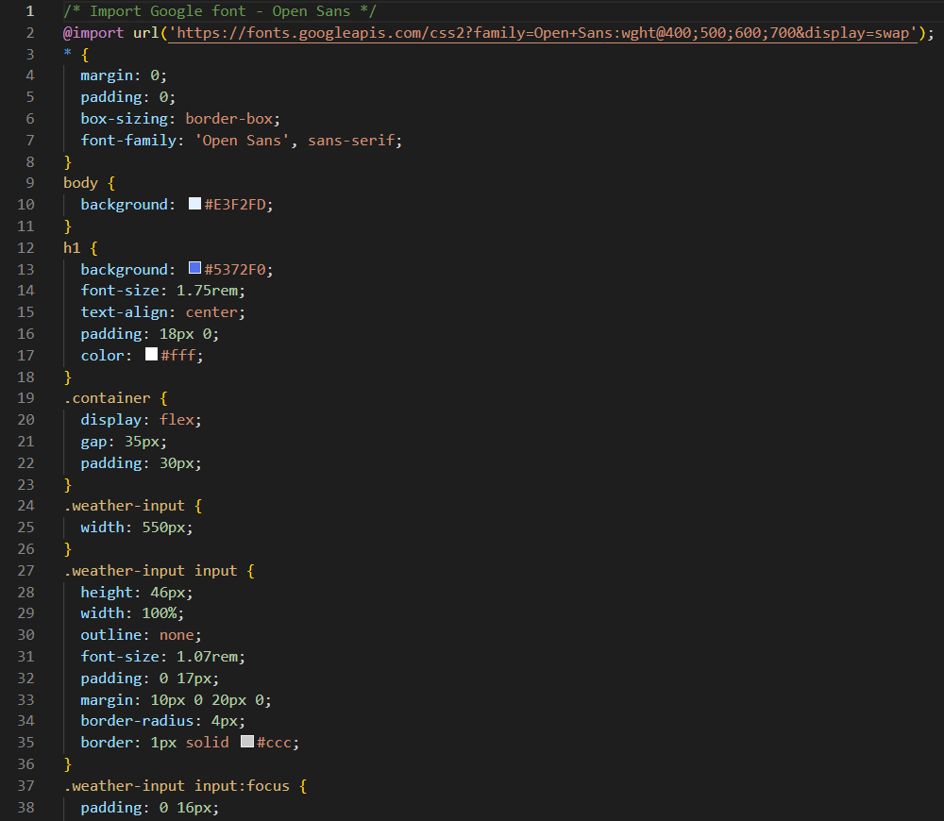
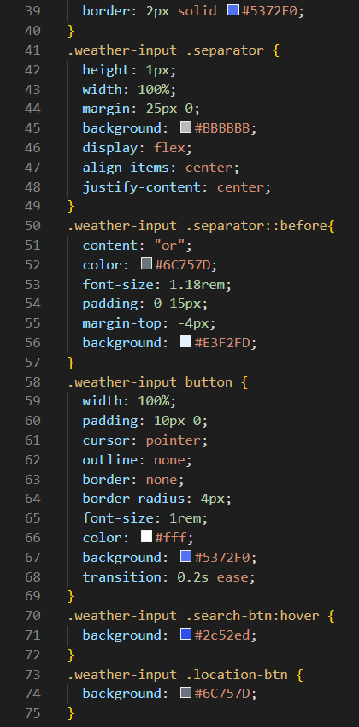
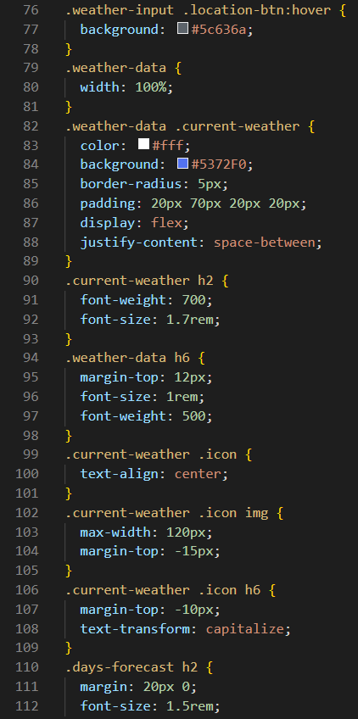
CSS Code: Part 1

Slide 5
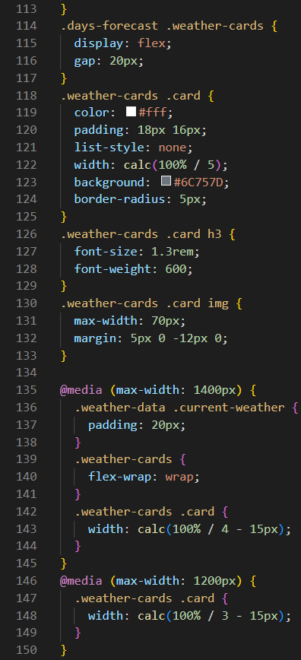
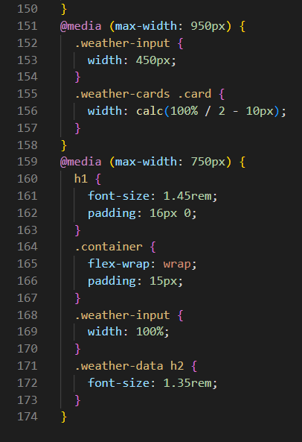
CSS Code: Part 2

Slide 6
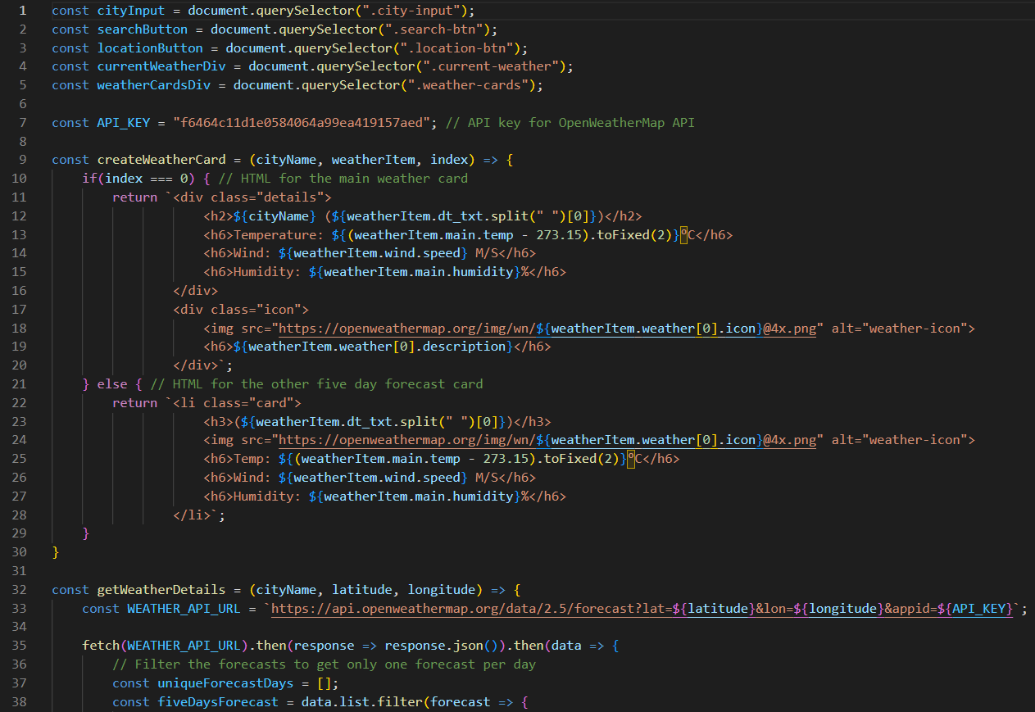
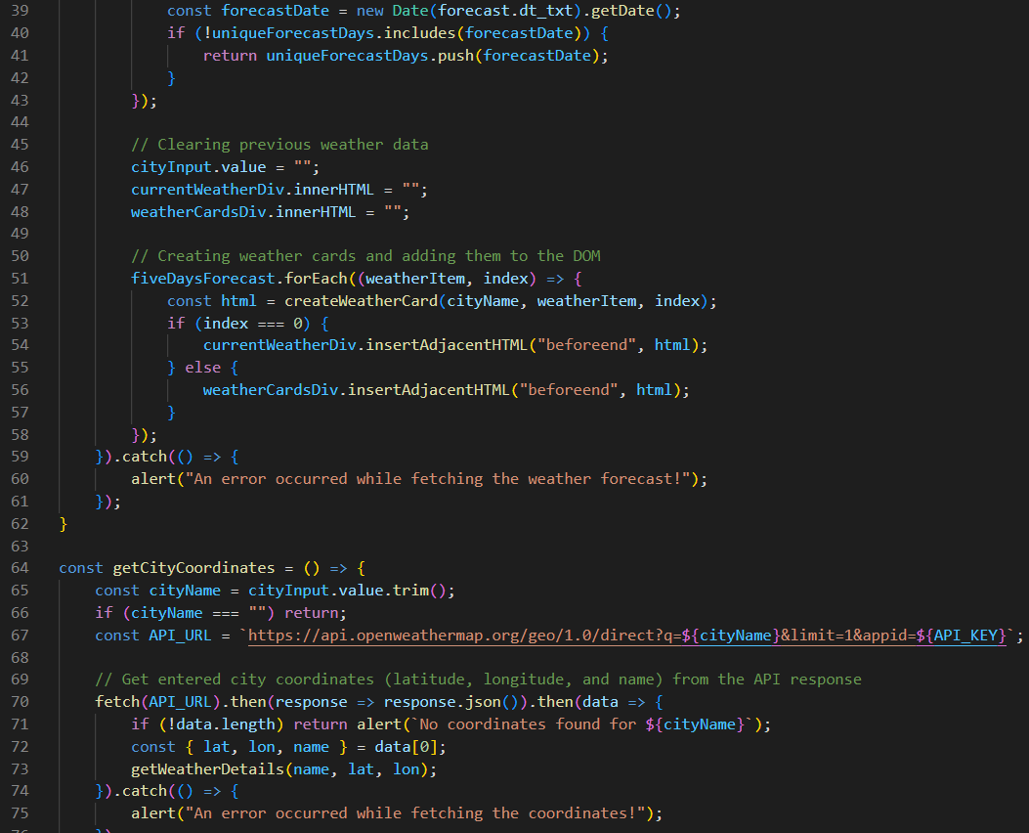
JSS Code: Part 1

Slide 7
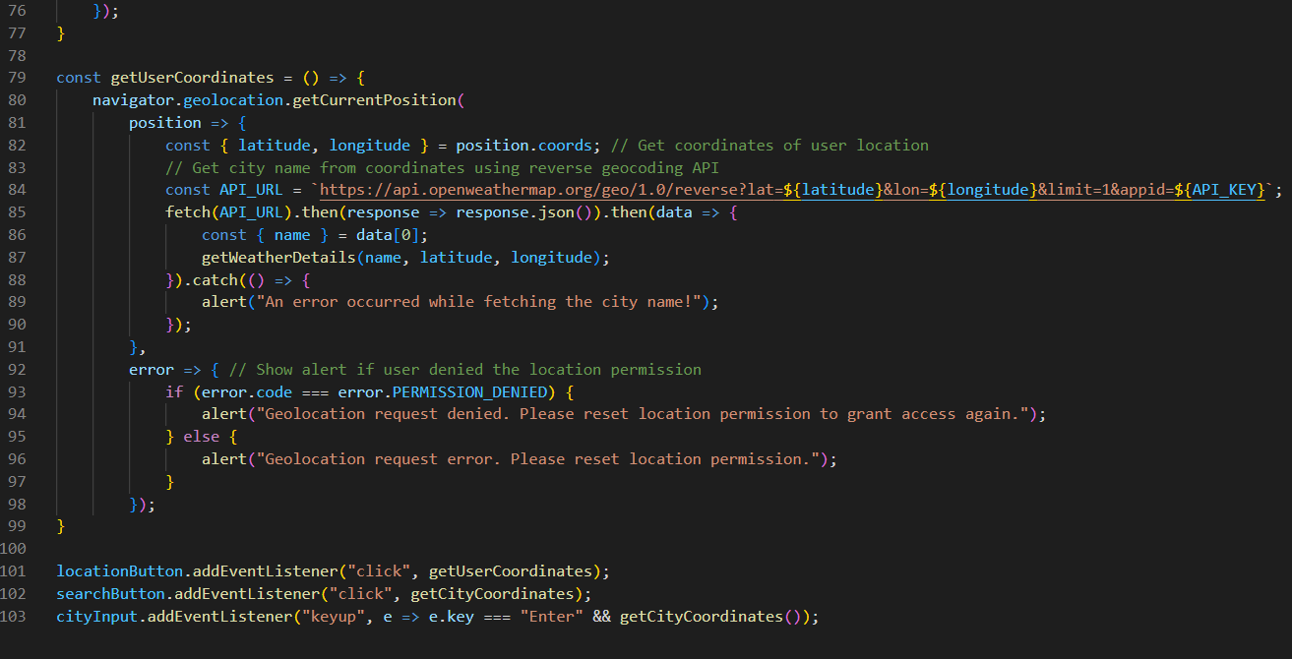
JSS Code: Part 2

Slide 8
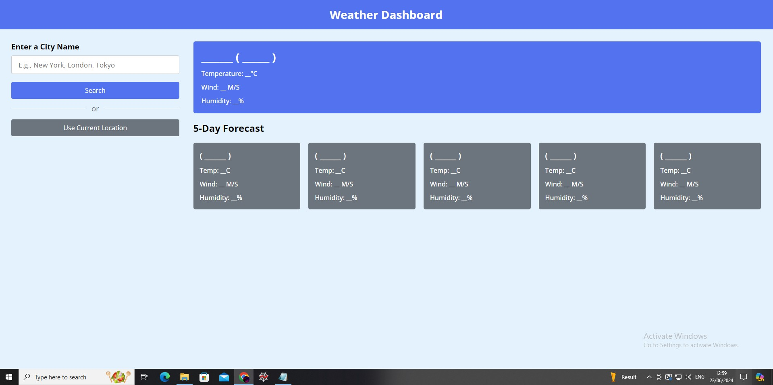
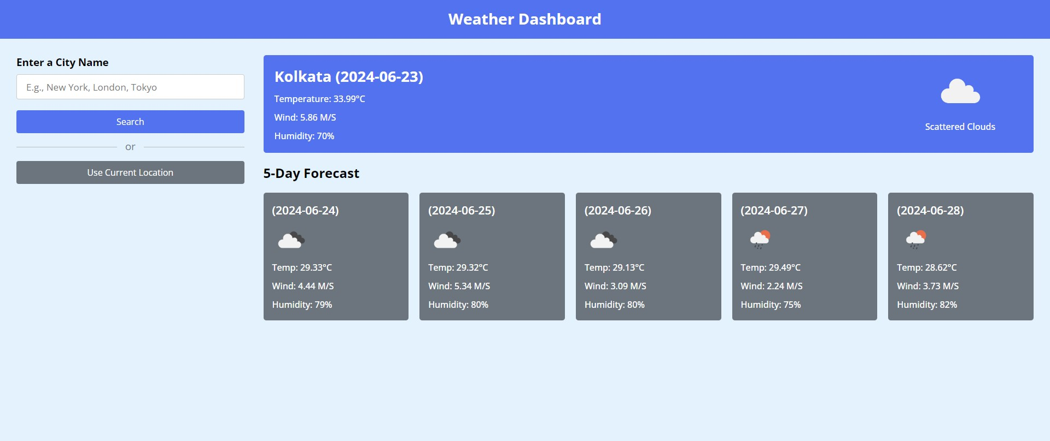
Outputs

